Slide 1

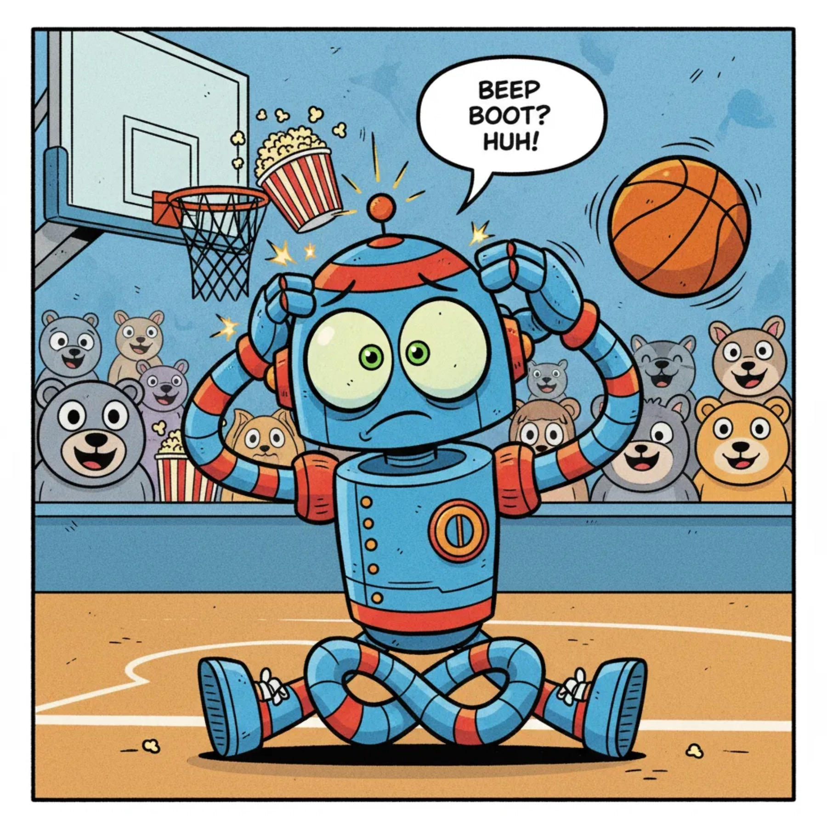
BEEP!
How Robots Learn from Mistakes!
Robo's Basketball Adventure
Group 1: Binte Zahra And Waseem
A04_TeamAI_BinteZahra_ITAI2376
Instructor: Sitaram Ayyagari

Slide 2
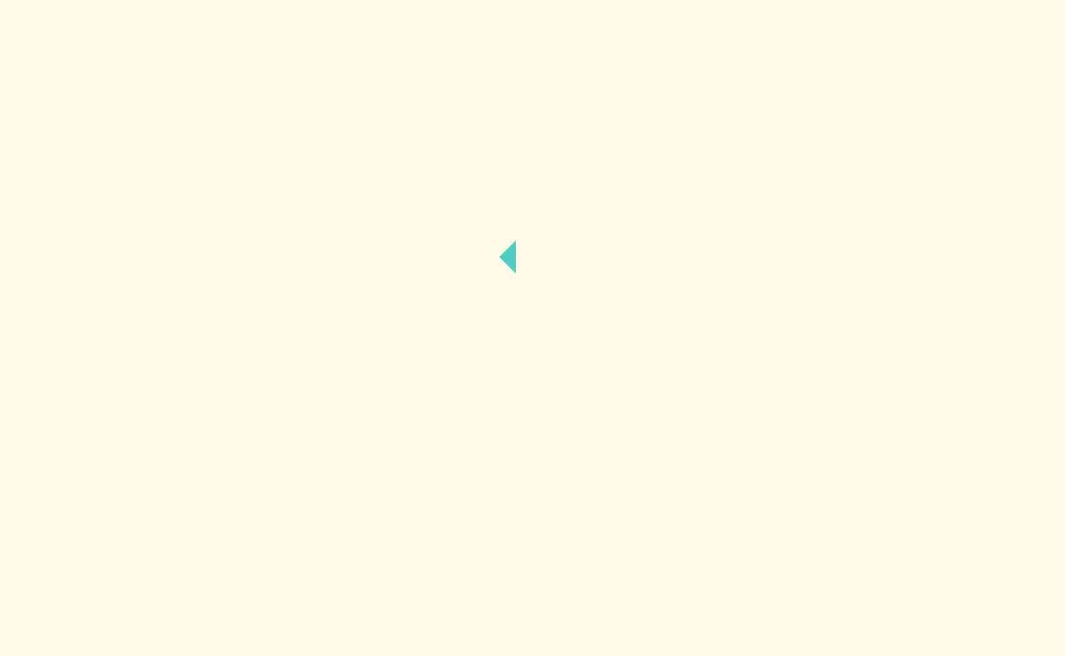
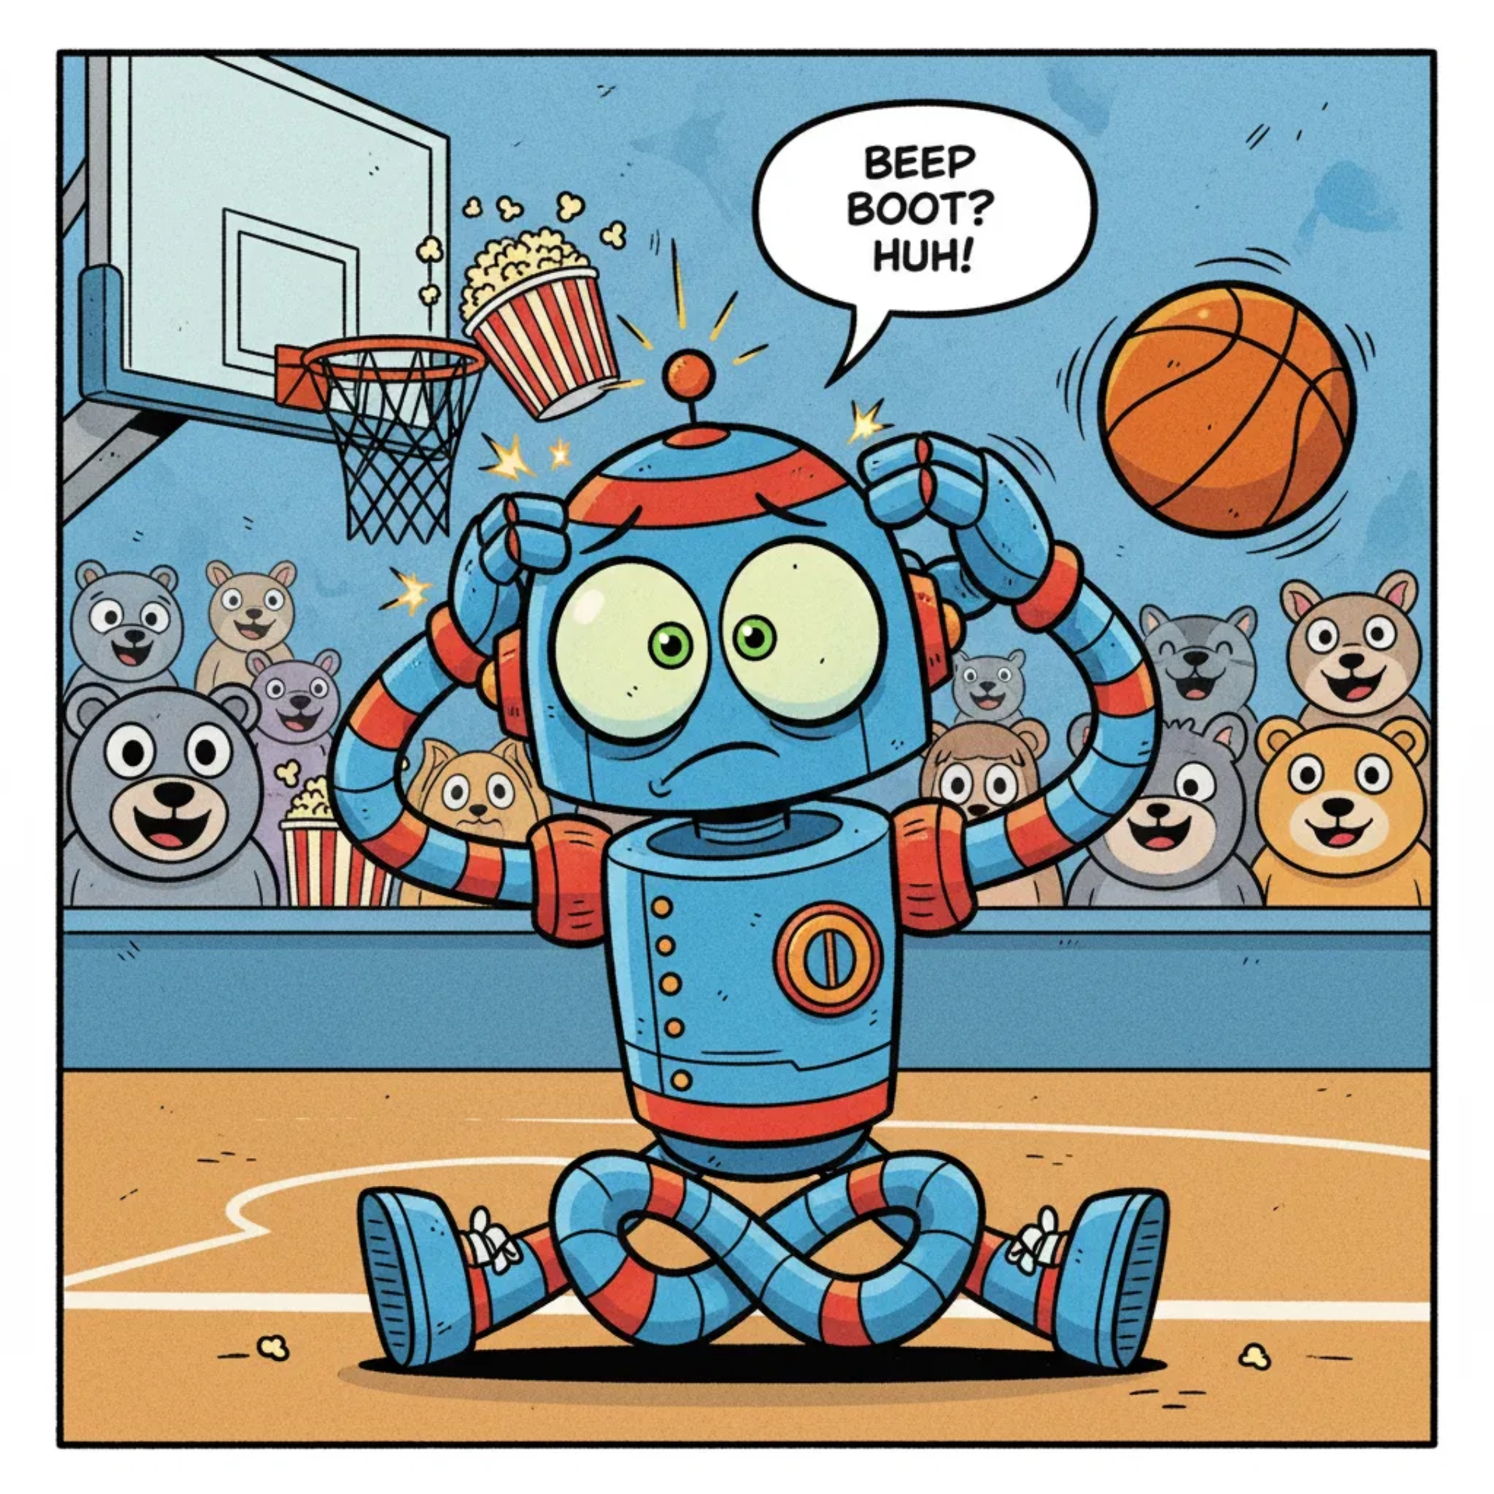
🤖 Meet Robo!
🏀
Robo wants to throw a ball.
He tries.
OOPS! He misses!
💡
How does Robo learn?
He wants to find out what went wrong!
That's
backpropagation!

Slide 3

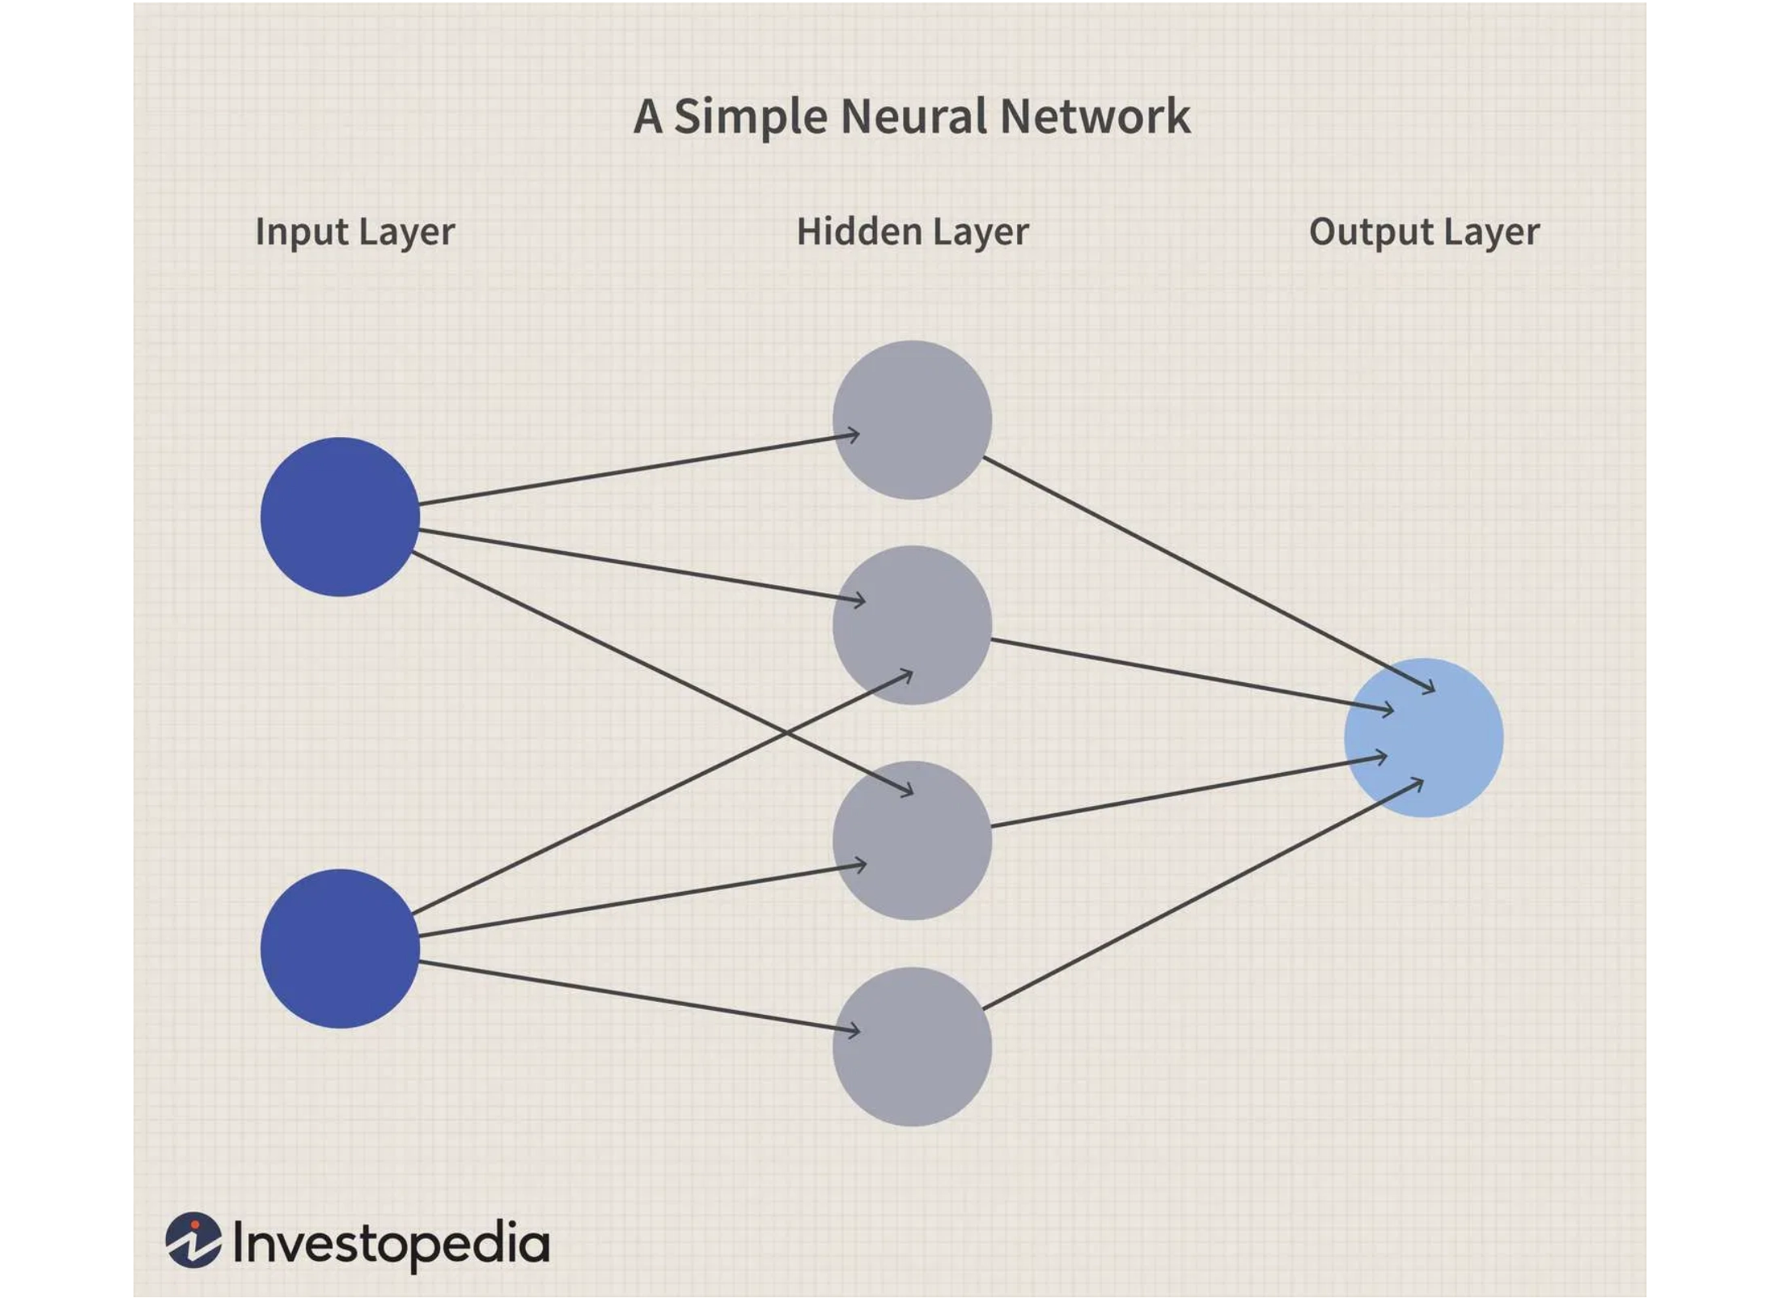
🧠 Robo's Brain
Robo has helpers called
neurons
.
They work in 3 layers!
👀
1. See
Looks at the basket
Input Layer: where information enters
🤔
2. Think
Figures it out
Hidden Layer: where thinking and decision-making happen
💪
3. Throw
Each circle is called a neuron, and the lines between them are connections that pass information forward.
Makes the shot!
Output Layer: where the final action happens

Slide 4
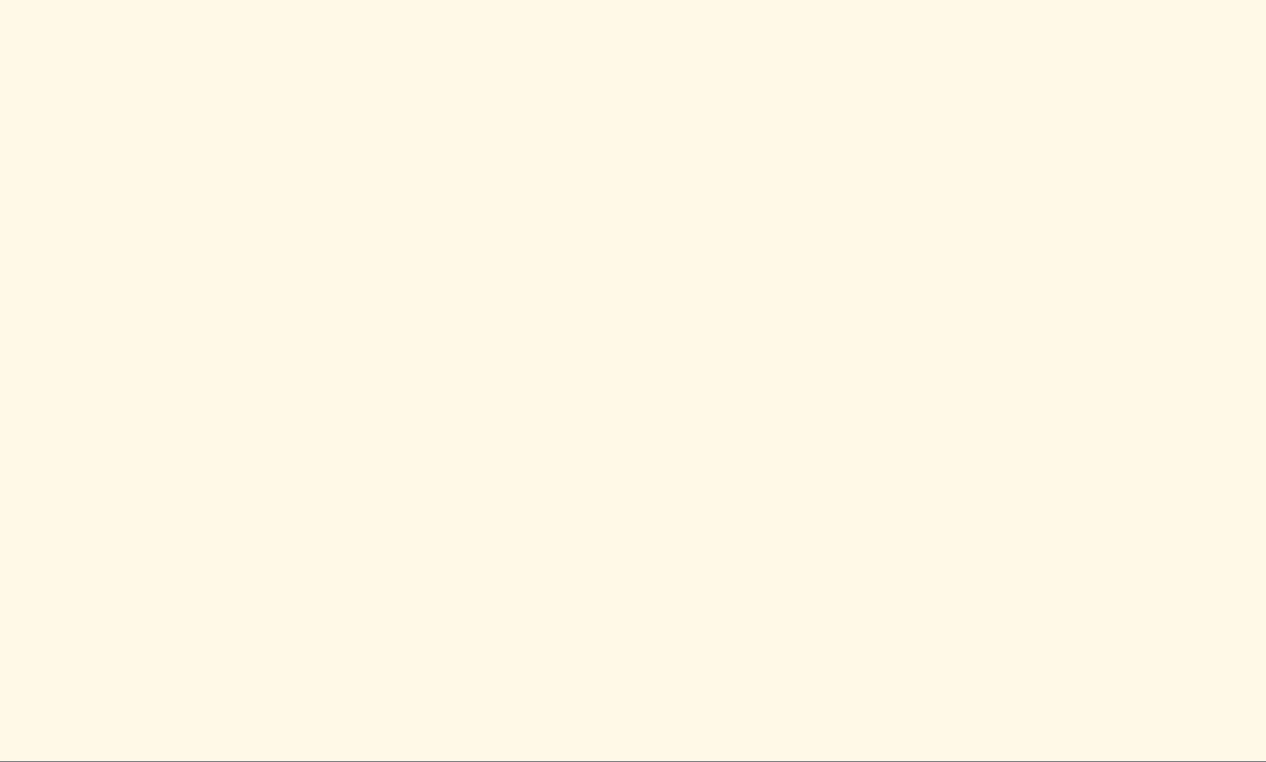
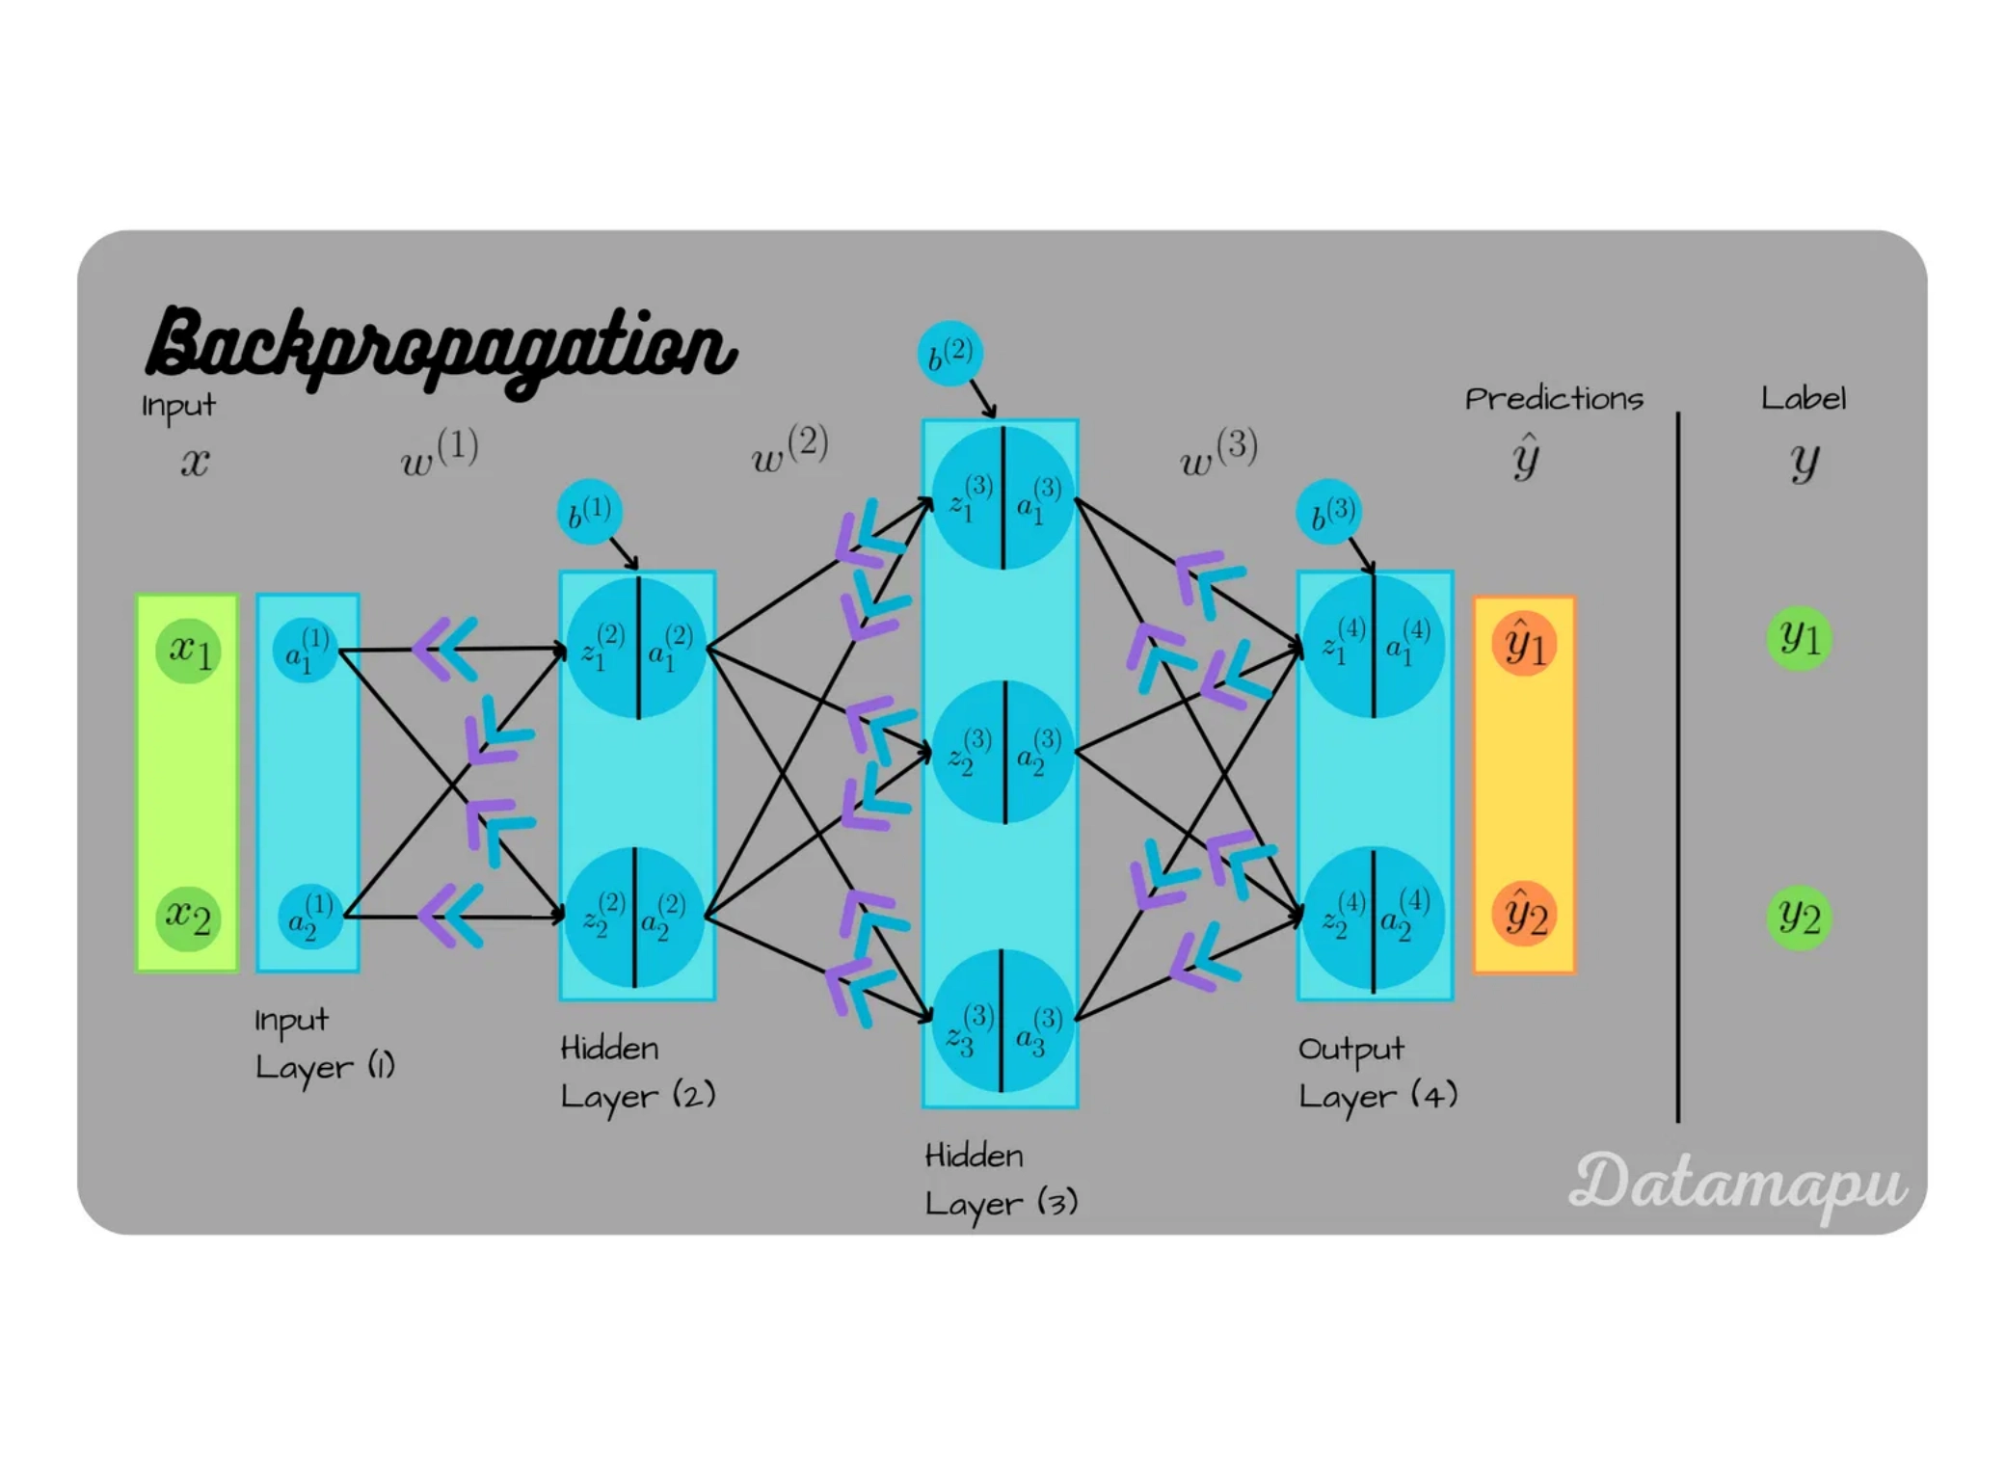
✨ Backpropagation Magic!
Robo missed the shot.
Now what?
1
Find the mistake
2
Send error backward
trying → failing → learning → adjusting → succeeding.
This mirrors how backpropagation actually works (forward pass, error, backward pass, weight update)
3
Each neuron learns!
🎓 Like a teacher helping students!
"You threw too soft!"

Slide 5

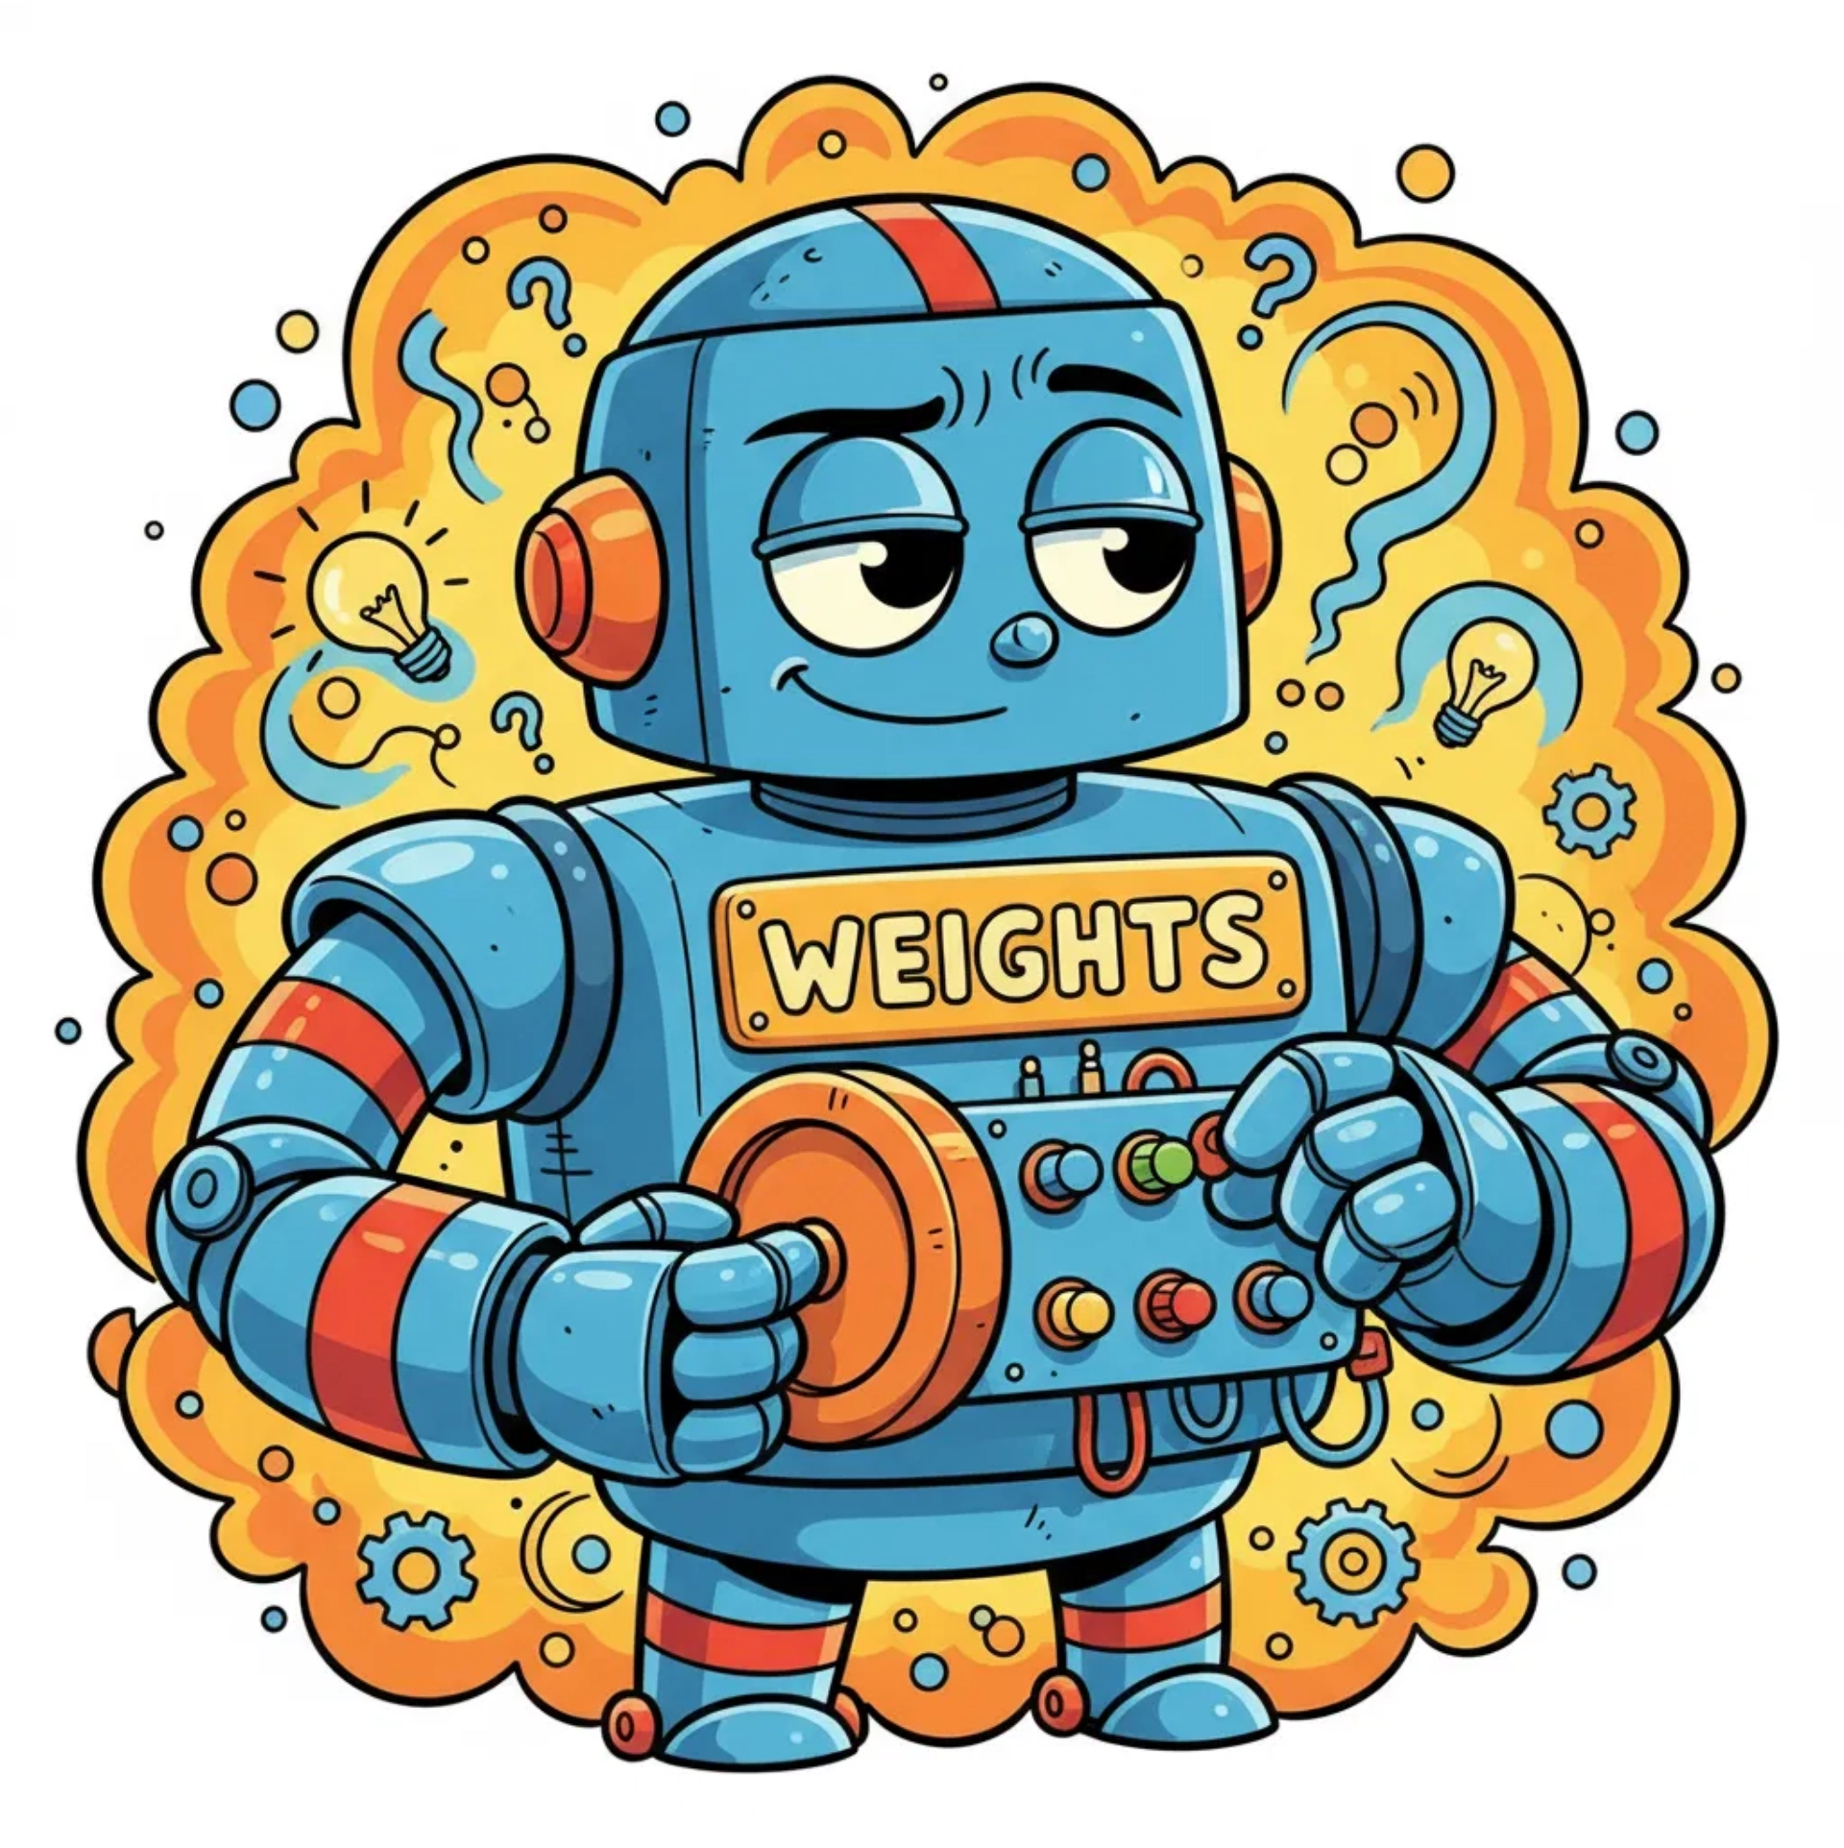
🎛️ Adjusting Weights
What are
weights
?
🎚️ They're like volume knobs!
Turn them up or down.
⬇️
Robo turns the knobs.
He tries again.
✨ Gets closer each time!

Slide 6


🏆 Robo Did It!
Robo practiced.
He learned from mistakes.
Now he's a champion!
📖 What is Backpropagation?
Sending errors backward so AI can fix mistakes and get smarter!
🚀 Used in:
⭐ Face recognition
⭐ Self-driving cars
⭐ Voice assistants
⭐ Video recommendations

Slide 7
Citations!
3Blue1Brown – What is Backpropagation?
Andrew Ng – Deep Learning Specialization
Simplilearn – Backpropagation Explained
Thank you!
Questions?

